Slide 1
Bias in Prompts
Identifying Bias in Prompt Design for AI Models

Slide 2

Introduction
Bias in prompt design can significantly impact AI outputs, leading to skewed or unfair results. Understanding the nature, sources, and effects of bias is crucial to improving AI fairness and accuracy. This presentation explores how to identify bias and mitigate its influence in prompt design practices.

Slide 3
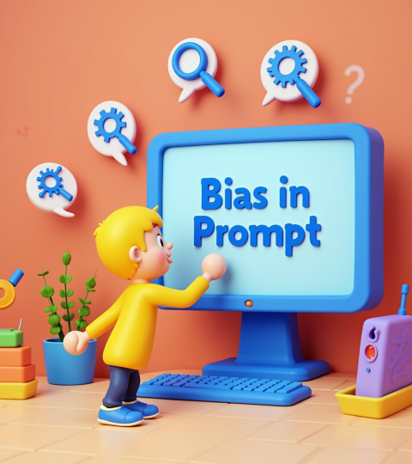
01
Understanding Bias in Prompt Design

Slide 4
Definition and Types of Bias
Bias refers to systematic errors or prejudices in AI responses, often reflecting stereotypes or unfair assumptions. Common types include selection bias, confirmation bias, and representation bias. Recognizing these helps ensure prompt design leads to more balanced and objective AI outputs.

Slide 5
Sources of Bias in Prompts
Bias can stem from ambiguity, leading language, or cultural and contextual assumptions embedded in prompts. External factors like dataset limitations and designer perspectives also contribute. Identifying these sources is key to creating unbiased, inclusive prompts for reliable AI interaction.

Slide 6

Impact of Bias on AI Outputs
Bias in prompts can lead to distorted or unfair AI responses, affecting decision-making and user trust. It may cause exclusion of certain groups or reinforce stereotypes, compromising the AIs reliability. Understanding these impacts highlights the importance of addressing bias proactively to ensure ethical and effective AI applications.

Slide 7

01
Strategies to Identify and Mitigate Bias

Slide 8

Techniques for Bias Detection
Identifying bias requires thorough review methods such as prompt testing across diverse scenarios, analyzing output variances, and using audit frameworks. Employing feedback loops with diverse user groups also helps reveal hidden biases and improve prompt design integrity.

Slide 9
Best Practices in Prompt Formulation
To reduce bias, use neutral and clear language, avoid leading questions, and incorporate diverse perspectives in prompt creation. Regularly revising prompts and combining quantitative and qualitative evaluations ensures more balanced, fair AI outputs.

Slide 10
Tools and Resources for Bias Analysis
Effective bias analysis leverages tools like AI fairness toolkits, anomaly detection software, and linguistic bias checkers. Access to updated datasets and collaboration platforms for sharing best practices further enhances bias identification and mitigation.

Slide 11
Conclusions
Effectively identifying and mitigating bias in prompt design is essential for producing fair and trustworthy AI results. By understanding bias types, utilizing detection techniques, applying best practices, and leveraging appropriate tools, organizations can improve AI reliability and foster ethical AI deployments.

Slide 12
Thanks
Do you have any questions? youremail@freepik.com
+91 620 421 838
yourcompany.com
Please keep this slide for attribution

